Slide 1


Weekly Progress Report
Lalith sai
2026-04-11
Visual Ai Lab, Control & Instrumentation Engineering

Slide 2
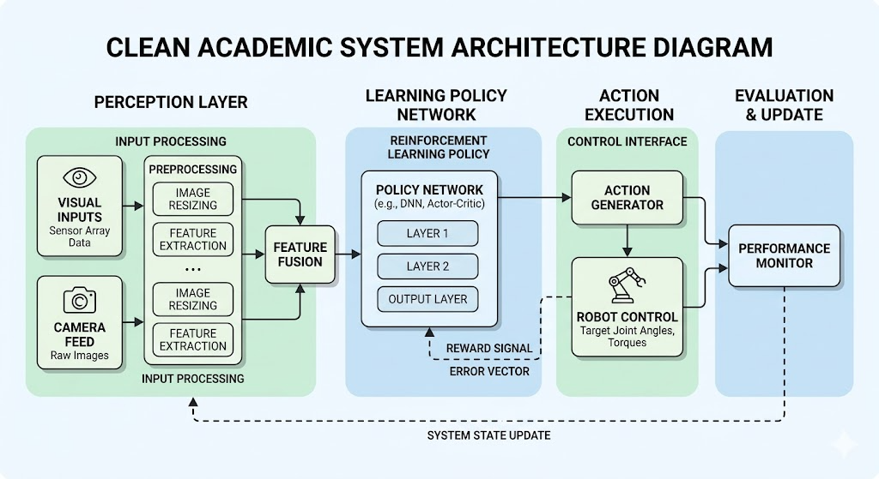

Jacobian-Structured Neural Action Synthesis for Reliable Vision-Language Robotic Manipulation

Slide 3
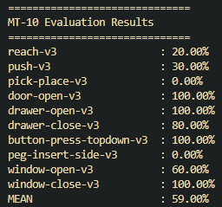
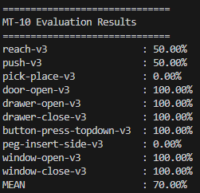
EVALUVATION ON MT-10 & MT-50
10 episode per task
total 100 episodes
59% successrate
2 episode per task
total 20 episodes
70% successrate

Slide 4
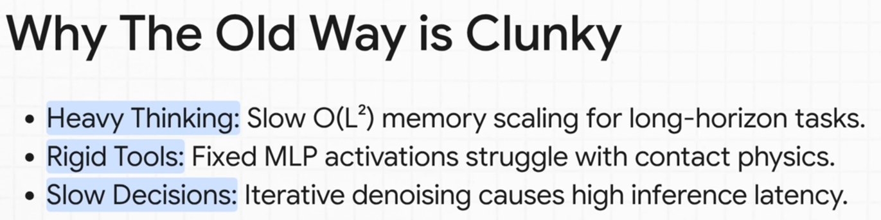
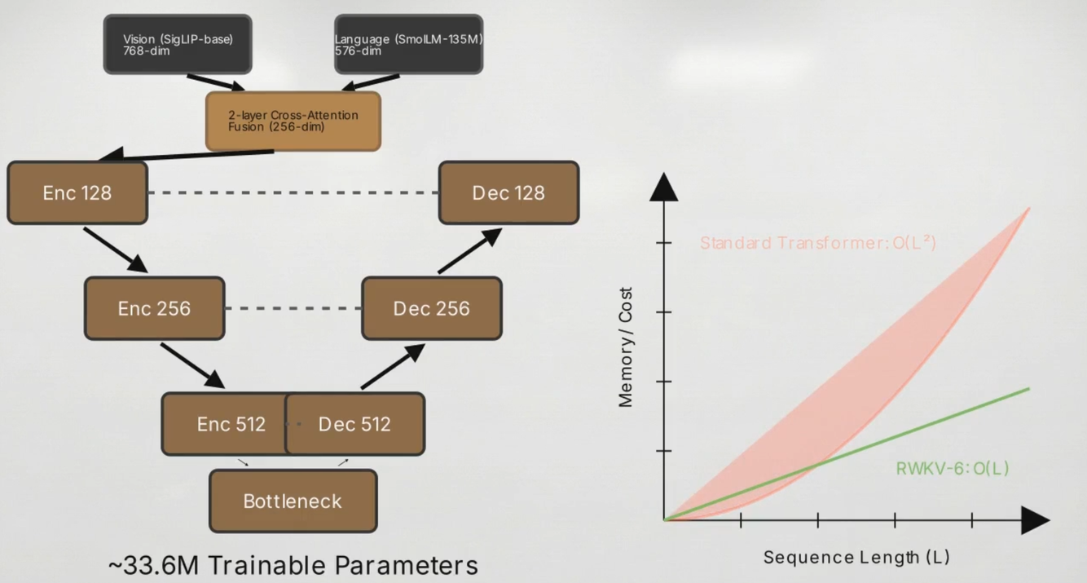
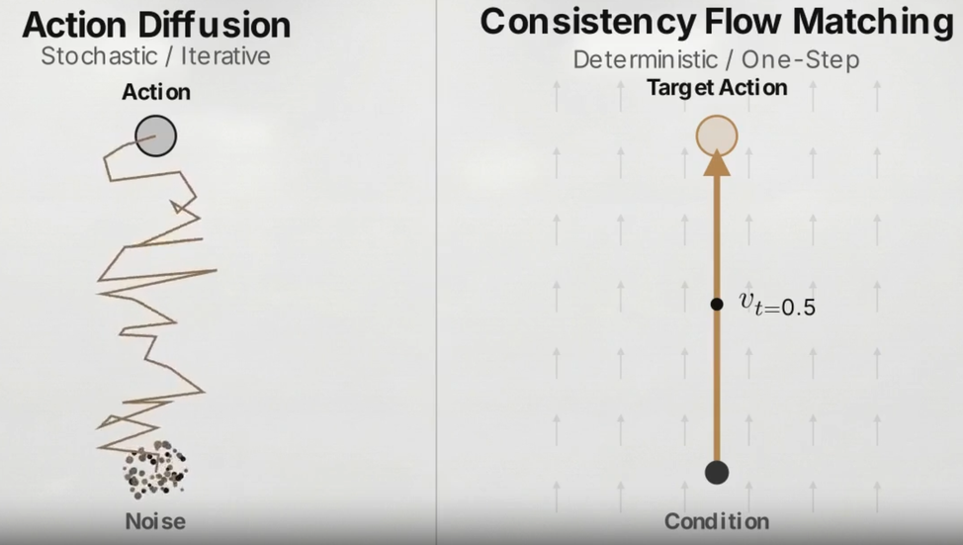
problem

Slide 5
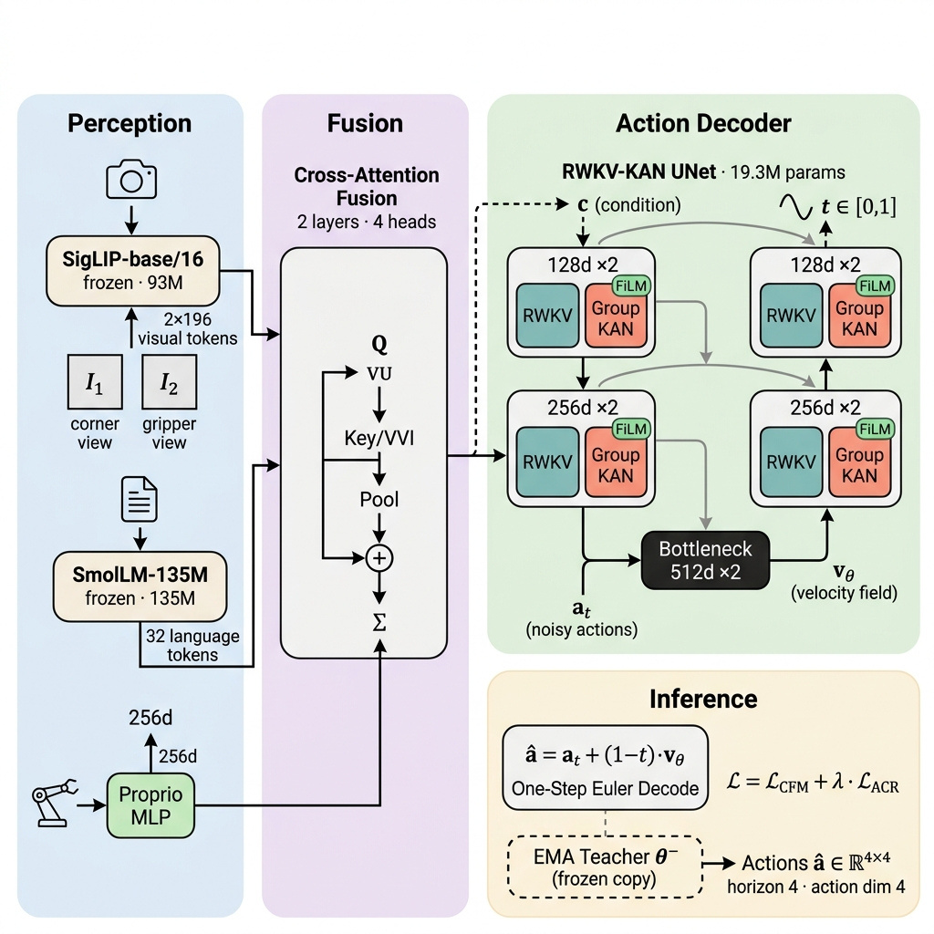
Generate robotic manipulation actions from multi-view images and language instructions in a single forward pass (~30ms) trained with only 10 expert demonstrations per task.

Slide 6
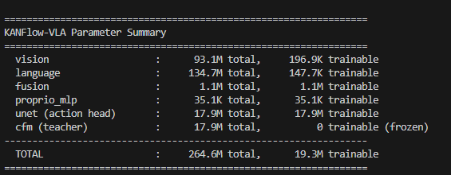
MODEL PARAMETERS
19.3M - Trainable
264.6M - TOTAL
[MetaWorldDataset] 5000 demos, 407000 windows, tasks=50

Slide 7
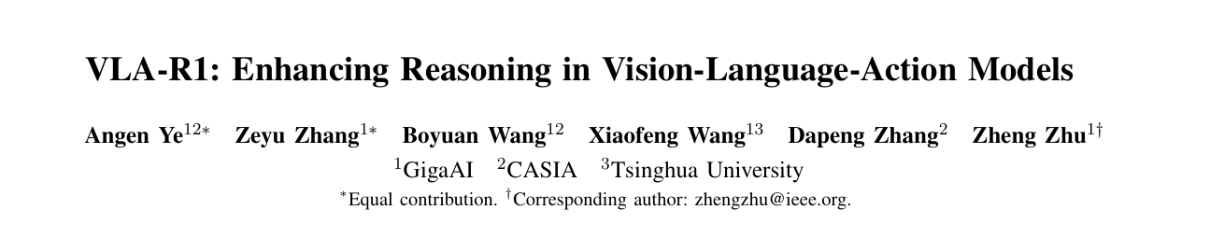
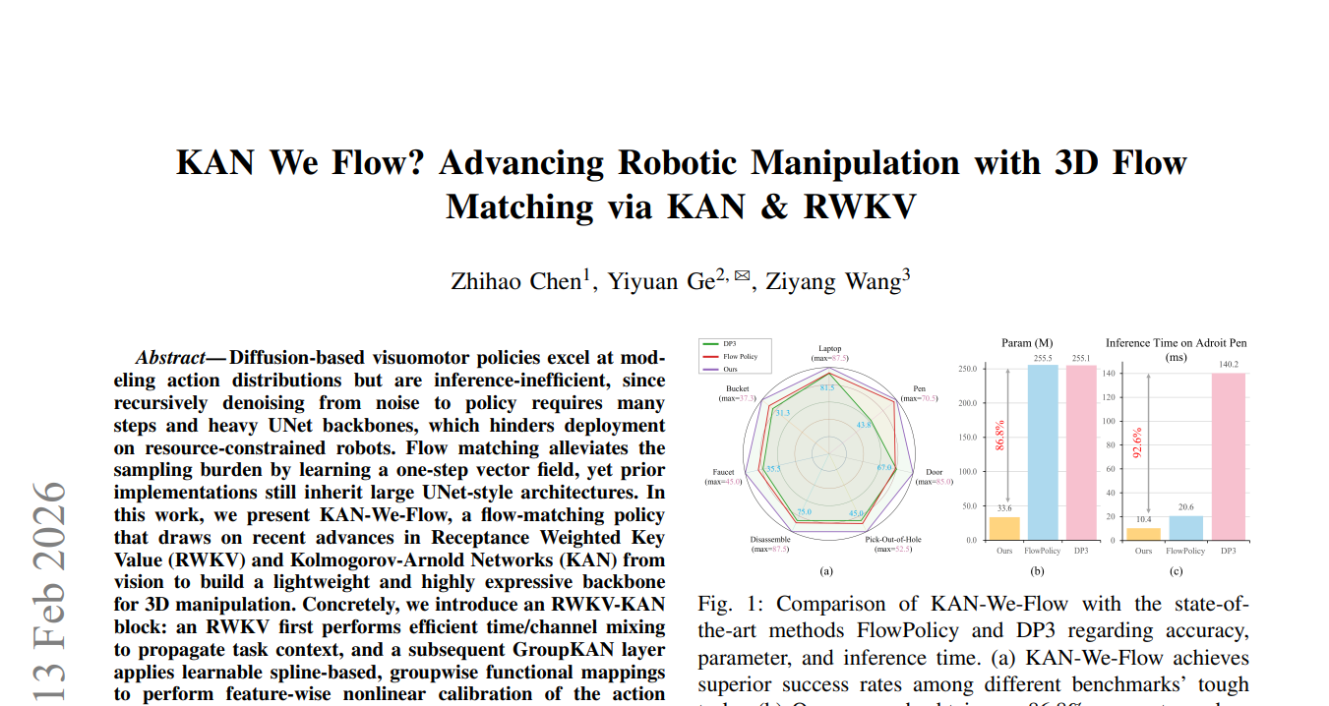
SEMINAR PAPER
Kan we REFERENCE

Slide 8
NEXT WEEK
Next Week plan
Training and testing model
Research more on meaningful contribution.

